Slide 1


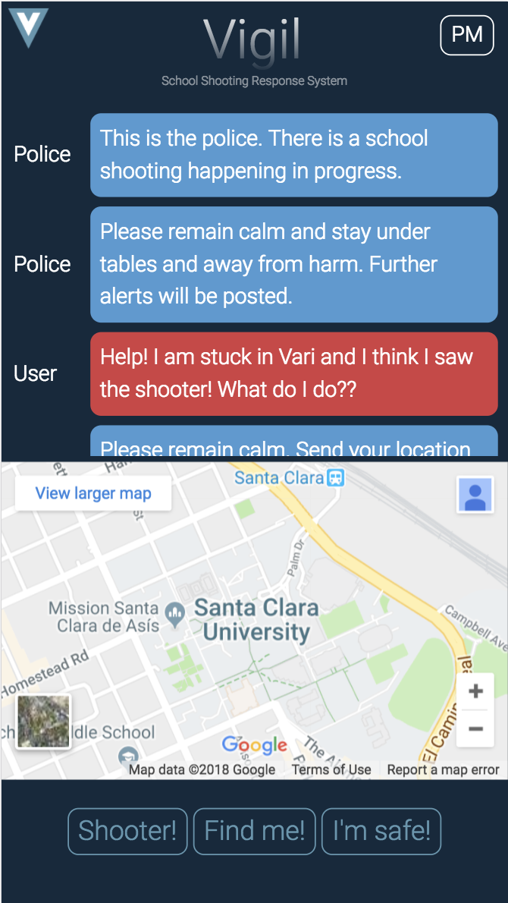
Vigil
SCHOOL SHOOTING RESPONSE SYSTEMS
HARSHAN, JUS, NISH, ADI, EVAN

Slide 2


Problem
School Shooters:
- Unpredictable
Rely on chaos
Heavily armed
Familiar w/ school environment
**No Emergency Response System**

Slide 3


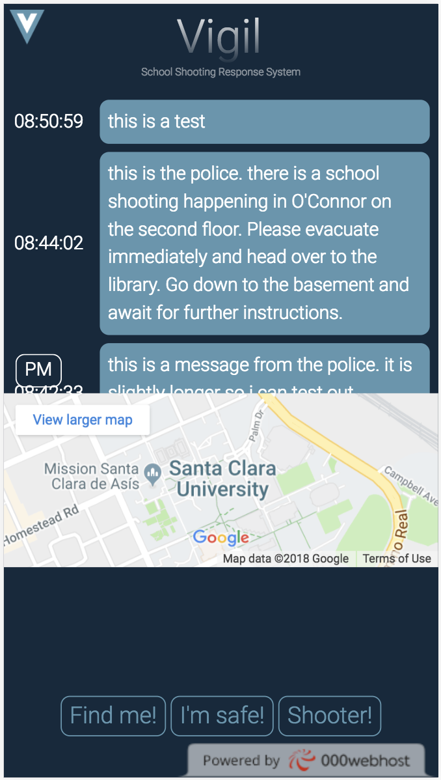
Goal
Directly link students to police
Provide police officers with real time updates on students
Organized Emergency Response System:
Faster communication/evacuation
Easy to capture shooter
Less injuries/casualties
Track student, define safe/unsafe areas
Send status, other updates
Update map, find safe routes
Track shooter, post alerts

Slide 4
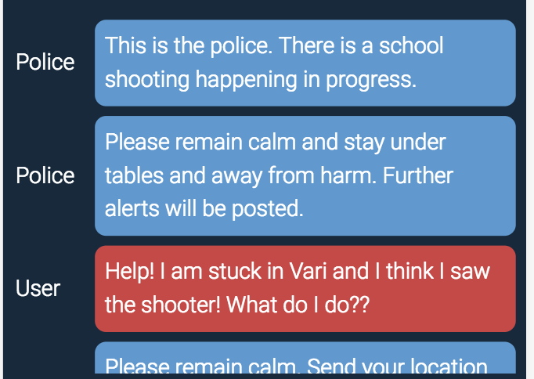
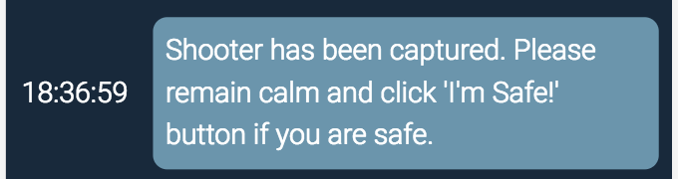

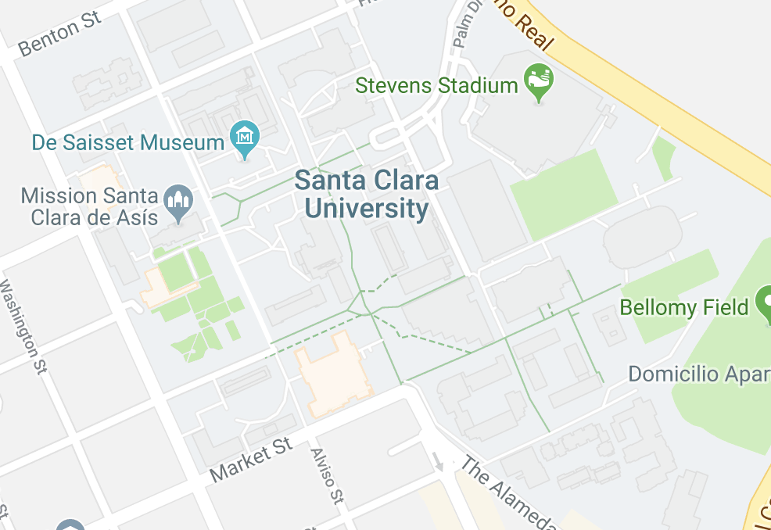
Functions
- Private Message
Student Side
- News Alerts from Police
- Quick Buttons
- Maps
Notes:
News Alerts
sent to all students registered in Vigil Database
Buttons
Shooter: Alerts Police of shooters location by dropping a pin on the map
Find Me: Drops a pin location on the map, indicating user’s location
Future Ideas: Google visual positioning system to figure out location on campus
I’m Safe: Sends notification to police that user is not in harm
Updates status of registered user on database from unsafe to safe
Maps
Identify safe zones, danger zones, evacuation routes
Future Ideas: Utilize google walking navigation

Slide 5
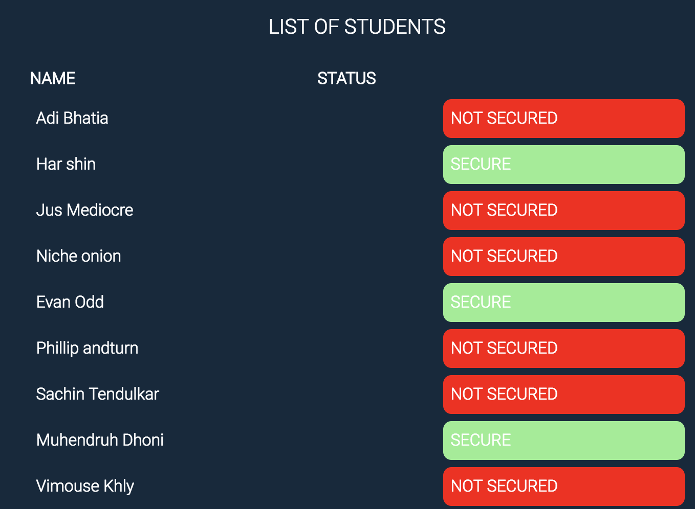
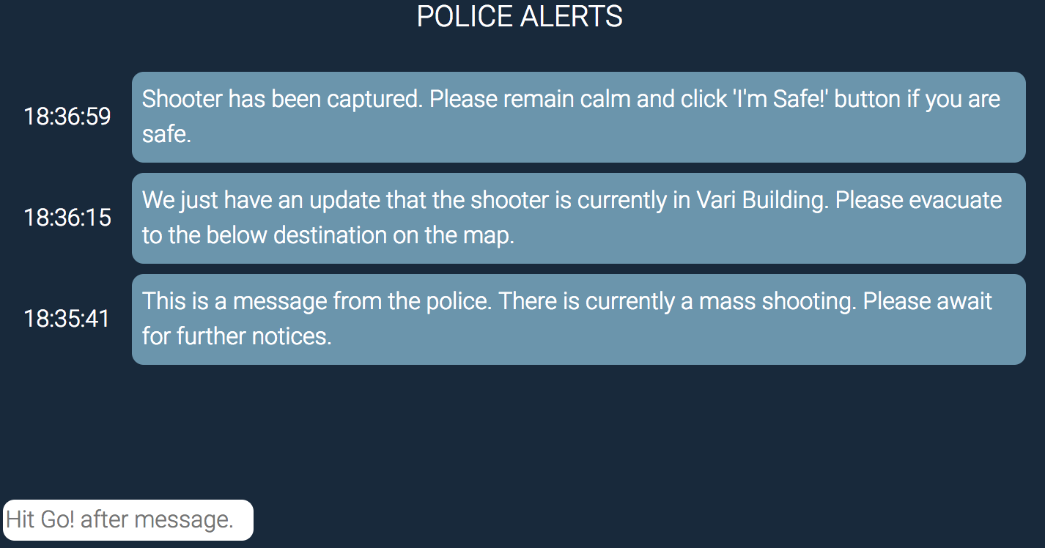
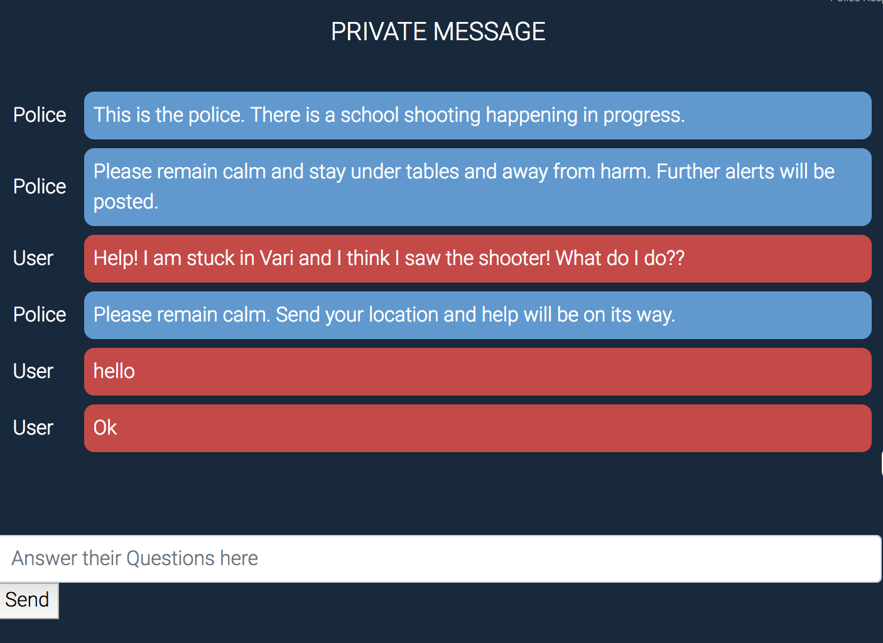




Functions
- List of Students
Police Control
- Sending Alerts
- Private Message
- Maps

Slide 6
Thanks!
Any Questions?

Slide 7
SWOT
Strengths
Weakness
Keeping students safe and communicating
First response system
Updated map of evacuation locations/routes
Private messaging
Shooter can be student w/ access
Students without smartphones don’t have access
Opportunity
Threats
Track shooter’s location based on sound/audio
Ongoing livestream tracking of students location
Implementing more maps
Creating student groups on campus
SaySomething (small apps)
Hero911 / School Guard (big systems)
Local Apps

Slide 8
THINKING AHEAD…
Version 2.0 Ideas?
How to get involved?

